Slide 1
A CBI Implementation for Students with Autism Senior Project
Tyler Romasco
Justin Gordon

Slide 2
What are we doing?
Teaching Assistant Device and Applications
Theories on Teaching Kids with Autism
Raspberry Pi

Slide 3
What is Austim?
A group of complex disorders of brain development
Also known as autism spectrum disorder (ASD)
Characterized by:
Difficulties in social interaction
Verbal and nonverbal communication
Repetitive behaviors.
Associated with:
intellectual disability
difficulties in motor coordination
attention and physical health issues (such as sleep and gastrointestinal disturbances)
Some persons with ASD excel in visual skills, music, math and art
Source: http://www.autismspeaks.org/what-autism

Slide 4
What is ABA?
Applied Behavior Analysis
Scientifically validated approach to understanding behavior and how it is affected by the environment
Has helped many different kinds of learners acquire many different skills
Can can improve communication, social relationships, play, self care, school and employment
Source: http://www.autismspeaks.org/what-autism/treatment/applied-behavior-analysis-aba

Slide 5
How do children with Autism learn?
Typically developing children learn that letters form sounds
For children with autism, words do not correspond to anything
This instruction makes words correspond to objects.
This is NOT “reading” (think shapes rather than words)

Slide 6
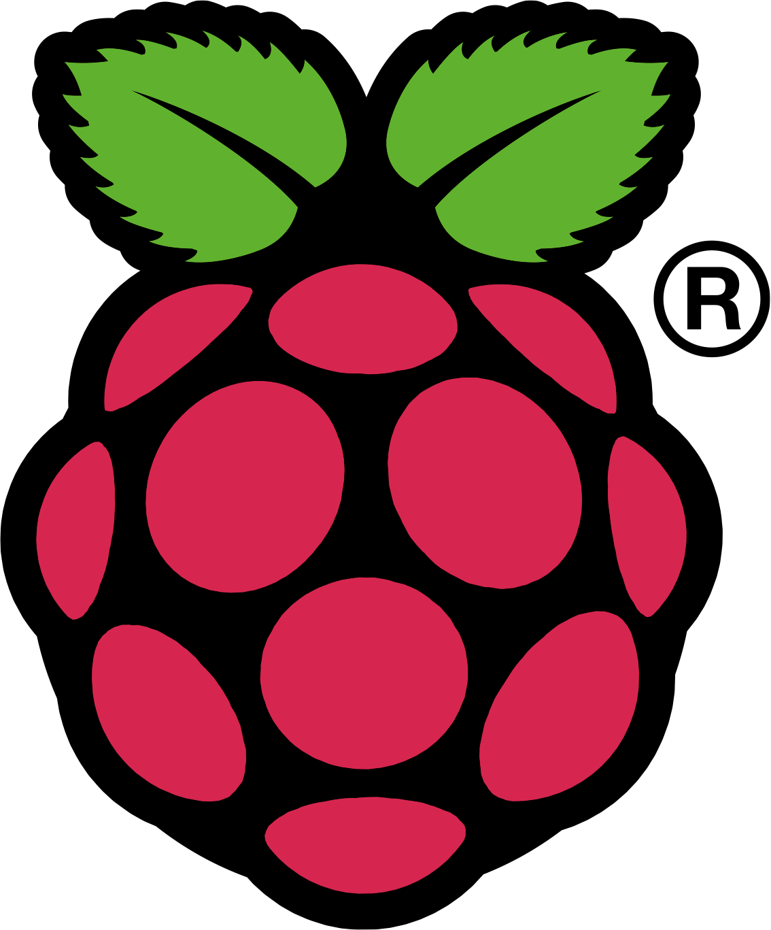
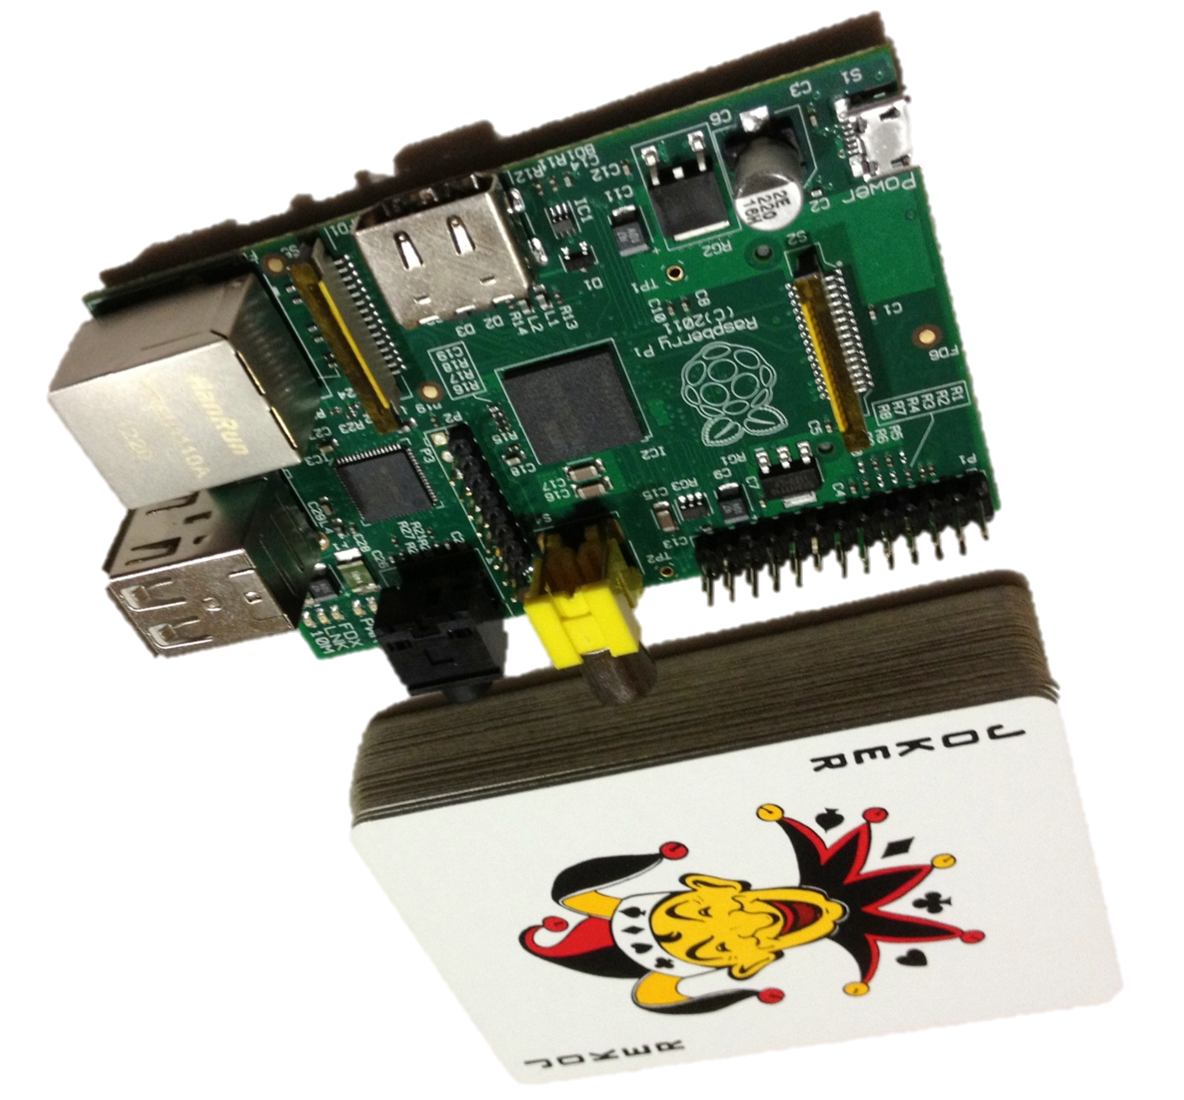
What is the Raspberry Pi?
A computer the size of a deck of cards that costs $35
Shown: Model B, Rev. 1

Slide 7
Who made the Pi? Why?
The Raspberry Pi Foundation is a non-profit based in the UK whose goal is to promote accessible programming tools to grade-school students and schools.

Slide 8
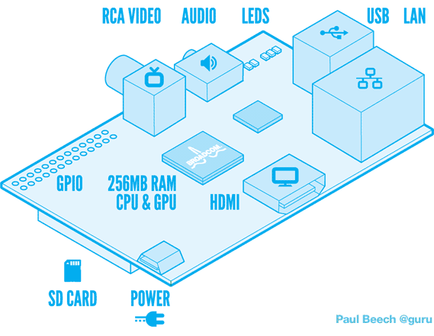
Raspberry Pi Model B Tech Specs
700 MHz ARM1176JZFS CPU (up to 1 GHz bursts)
Videocore 4 GPU
H.264, 40 Mbit/S Decoding (Blu-ray quality)
Usable with OpenGL ES2.0 and OpenVG
256 MB RAM
2 USB ports
10/100 Ethernet
HDMI / Composite video out
HDMI / 3.5 mm audio out
Powered by micro USB
700 mA @ 5V, ~ 2 watts
Boots off removable SD card
Source: raspberrypi.org
Diagram courtesy of Paul Beech

Slide 9
What can it run?
Linux, of course!
Raspbian Linux based on Debian
Can use LXDE windowing system
Languages currently supported:
Python
C
(Future) Java

Slide 10
Potential Uses
Intended:
Personal programming environment for every student
Possible Uses:
Media center (for TV)
Low-powered NAS server
Small Minecraft server
Robot controller
You can buy one too!

Slide 11
How does one combine Autism and a humble Raspberry Pi?
We are going to build a teaching assistant on top of the Raspberry Pi platform
Build app(s) on top of Raspbian that incorporate CBI concepts
Collect data from the applications that students use to track progress and identify areas of improvement

Slide 12
Applications We Can Make
Word Walls
Multiple choice

Slide 13
Goals
Get input from real teachers to use in application(s)
Build 1 or 2 applications based on CBI concepts
Implement data collection and analysis into applications
Install them onto a Raspberry Pi
(Potentially) collect data via server
(Potentially) beta test on real students

Slide 14
Timeline
Mid October – Collect requirements from teachers
November – Develop applications
December/January – Develop data collection and analysis
January/February – Beta test

